Slide 1

Realtime Blood Management System
Phase 2
Supervisor name: Divya Verma(E13867)

Slide 2
Team Members
Aayush Kumar Singh UID: 21BCS7008
Anoop Kumar UID: 21BCS7055
Dhuriya Ankit Subhash UID: 21BCS6952
Ishica UID: 21BCS7050
Sakshi Bajpai UID: 21BCS6938
Branch: Computer Science & Engineering

Slide 3
Mission
Vision
Make a system to provide a interface to the user for acknowledgement of the donors and blood bank which have the needed blood type.
Interface works a link between the donor and recipient or blood bank details view.
Develop a fully functional System which provide a better facility to the people of society, who are in need of blood and who wants to a participant in the donation work.

Slide 4
Key Feature of project
Donor registration
Real-time location
Donor search
Blood inventory management
Appointment scheduling
Donor communication
Reporting and analytics
SMS/Email Notifications
Donor Management

Slide 5
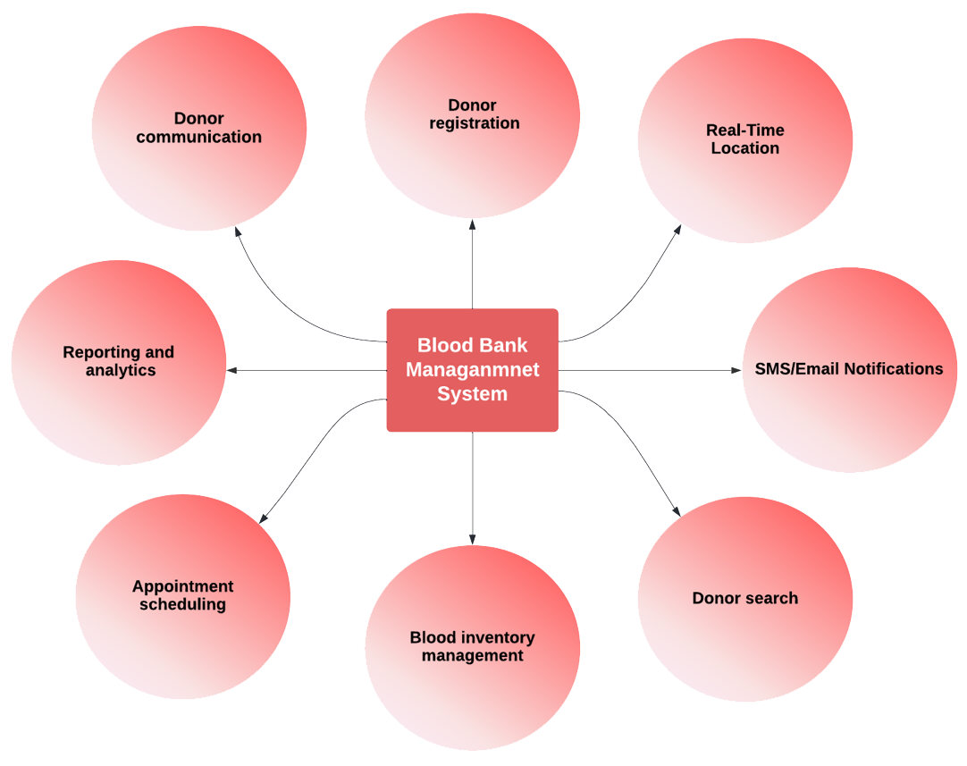
Figure1: Key features of the Realtime blood management system

Slide 6
Drawbacks of Blood Management System
Shortage of blood
Matching Issue
Blood-borne diseases
Administrative inefficiencies
Donor eligibility
Donor recruitment

Slide 7
Work Update
We had made the basic structure(UX/IX) of the website.
All Webpages are successfully linked and working properly.
Database frame has been established(attributes).
Logo of the website has been designed.
Literature review has been done.
Potential risk analysis are calculated.

Slide 8
Work Update (cont..)
We had made the basic structure(UX/IX) of the website.
All Webpages are successfully linked and working properly.
Database frame has been established(attributes).
Logo of the website has been designed.
Literature review has been done.
Potential risk analysis are calculated.

Slide 9
Thank you

